Slide 1
Operation Analytics and Investigating Metric Spike
Name – Samiksha Zagade

Slide 2
PROJECT DESCRIPTION
In this project our key aspect of Operational Analytics is investigating metric spikes. Operational Analytics is a crucial process that involves analyzing a company's end-to-end operations. This analysis helps identify areas for improvement within the company. In this project, I have used SQL and MySQL Workbench as a tool to derive insights from this data to answer questions posed by different departments within the company. We have segmented the analysis in two parts – Case study 1 and Case Study 2. The questions posed by the team and the insights are as follows for the respective Case studies.

Slide 3
Case Study 1: Job Data Analysis
In this segment our focus is only one table job_data. We first started by creating a database for the project and then created the necessary table job_data using the provided table structures. Here we had to derive insights for questions like –
Jobs reviewed overtime
Throughput Analysis
Language Share Analysis
Duplicate Rows Detection

Slide 4
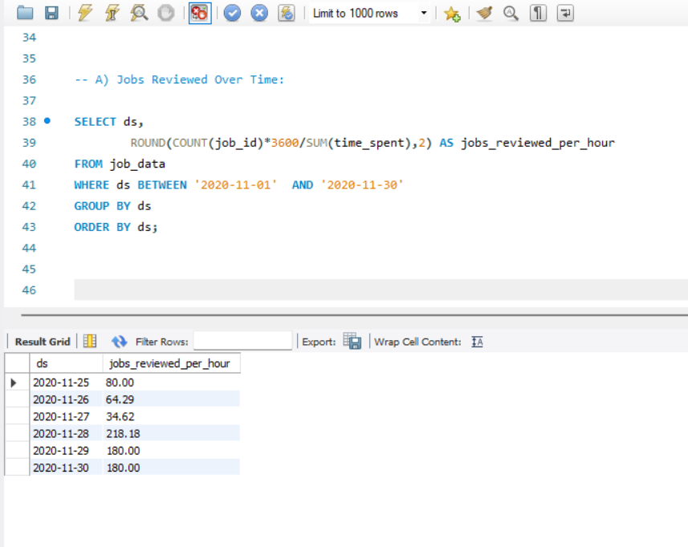
Jobs reviewed overtime
Then we have found the number of jobs reviewed per hour for each day in November 2020.
Maximum jobs were reviewed on 28 November 2020.
Minimum jobs were reviewed on 26 November 2020 with 29 and 30 November having similar number of jobs reviewed per hour.

Slide 5
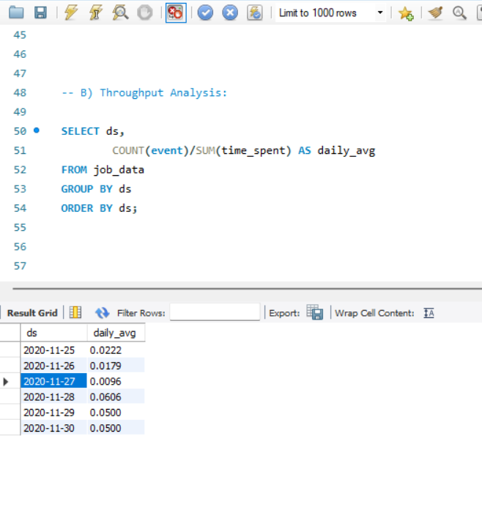
Throughput Analysis
Next we have calculated the 7-day rolling average of throughput that is the number of events per second.
I prefer using the 7-day rolling average for throughput over daily metric because 7-day rolling average smooths out the fluctuations in the data and provides a more accurate representation of the overall trend.

Slide 6
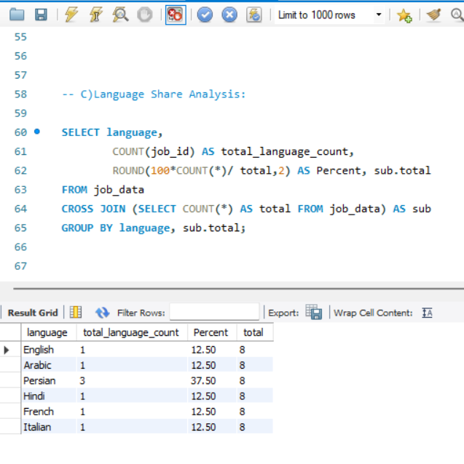
Language Share Analysis
Next we have found the percentage share of each language in the last 30 days.
The percentage of Persian Language is 37.5% in the last 30 days is pretty high compared to most of the other languages having 12.5%.

Slide 7
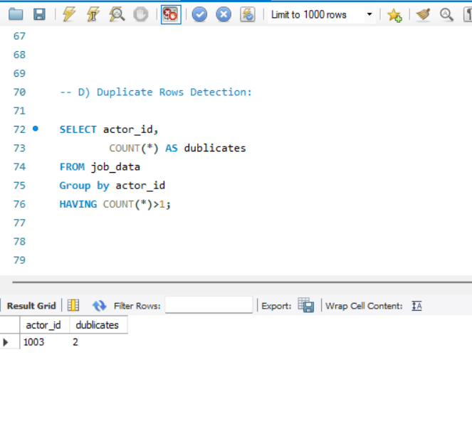
Duplicate Rows Detection
The next step was to identify duplicate rows in the data.
The actor id 1003 had two rows and was the only duplicate column.
Otherwise there was no duplication of any column.

Slide 8
Case Study 2
The second case study consists of 3 tables users, events and email events. We had to create the database and then we had to make proper necessary tables named users, events and email events and import the data from excel sheet. After importing the data we first understood the data and then started working on it. Some questions were answered –
Weekly User Engagement
User Growth Analysis
Weekly Engagement Per Device
Email Engagement Analysis

Slide 9
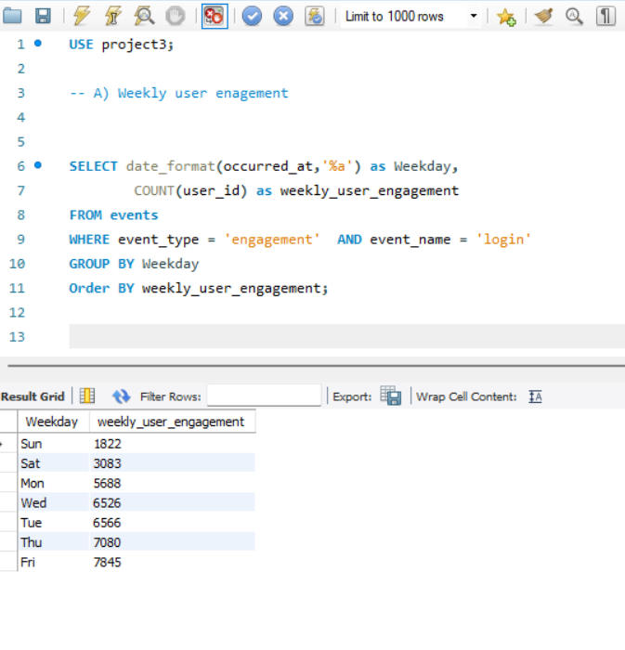
Weekly User Engagement
We first measured the activeness of users on a weekly basis.
Friday had the highest user engagement compared to other weekdays followed by Thursday.
The least engagement was on Sunday which is quiet surprising as on holidays the engagement should be maximum but Friday has the maximum engagement of users.

Slide 10
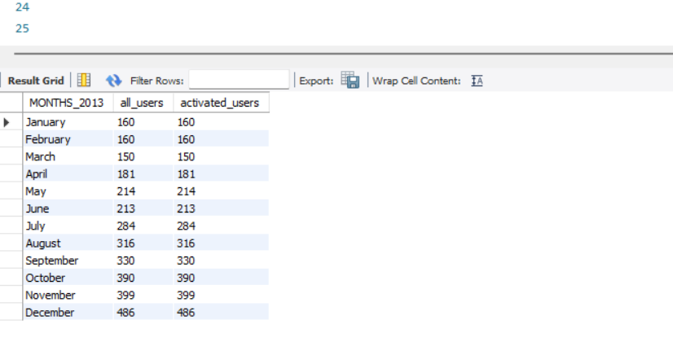
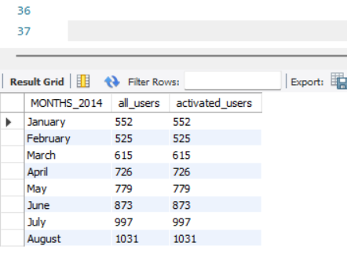
User Growth Analysis
Next step was to analyze the growth of users over time for a product or in simple word analyze the user growth for the product.
December has the highest active user in 2013 but in 2014 August had the highest active users.
Also the number of users have increased since 2013 to 2014 there is significant growth.

Slide 11
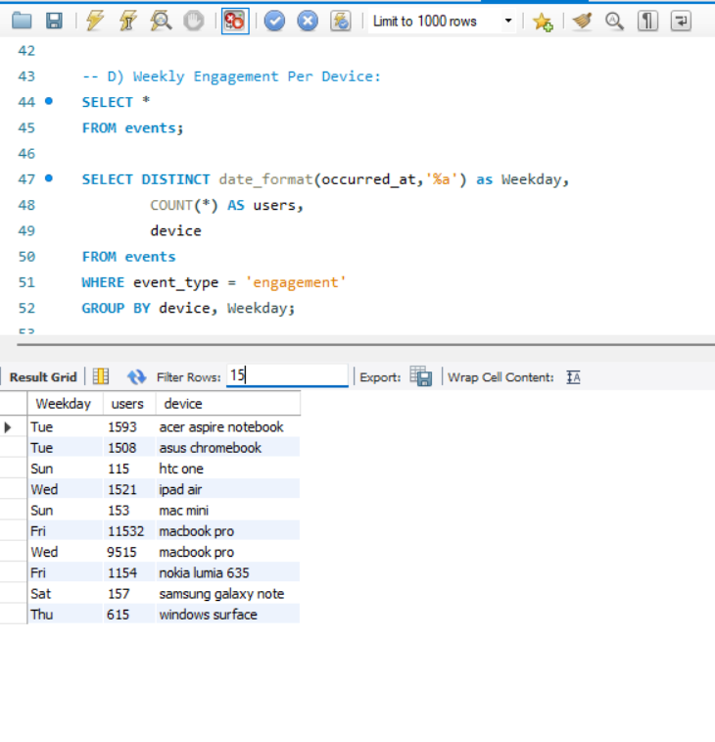
Weekly Engagement Per Device
Next we measured the activeness of users on a weekly basis per device.
The device macbook pro has highest user activeness.

Slide 12
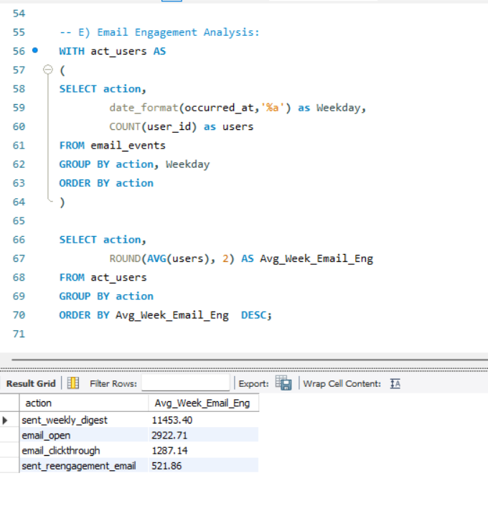
Email Engagement Analysis
Next we saw how users are engaging with the email service.
Sent_weekly_digest was the user mostly engaging with the email service with an average email engagement being 11453 approximately.

Slide 13
Tools Used
The tools that I used to do this analysis is SQL(Structures Query Language) and the software used is MySQL Workbench. I chose to do this project in this software because of the ease by which we can handle and analyze the data here is very good. SQL is very helpful when we work on relational databases which was one of the reasons why I chose them for the project. SQL enables us to make insights on the past data.

Slide 14
Insights and Results
Working on the Case study 1 we gained some insights on the data.
Maximum jobs were reviewed on 28 November 2020.
7-day rolling average for throughput is prefered over daily metric because 7-day rolling average smooths out the fluctuations in the data and provides a more accurate representation of the overall trend.
Persian Language has highest percentage (37.5%) in the last 30 days in comparison to other languages having 12.5%.
The actor id 1003 had two rows and was the only duplicate column.

Slide 15
Insights and Results
Next we worked on the Case study 2.
Friday had the highest involvement when we found the weekly user engagement.
December has the highest active user in 2013 but in 2014 August had the highest active users.
The highest user activeness was the device device macbook pro.
Sent_weekly_digest was the user mostly engaging with the email service.

Slide 16
Thank You

